Slide 1
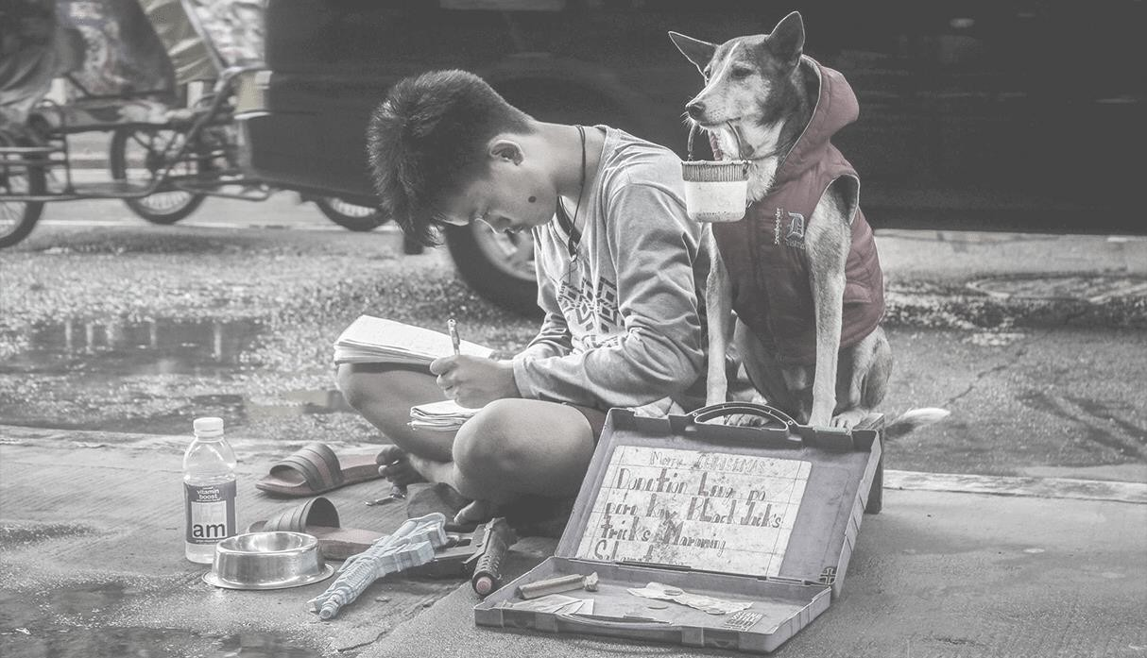

Decision trees
to predict a student’s
performance on Saber
Pro

Slide 2
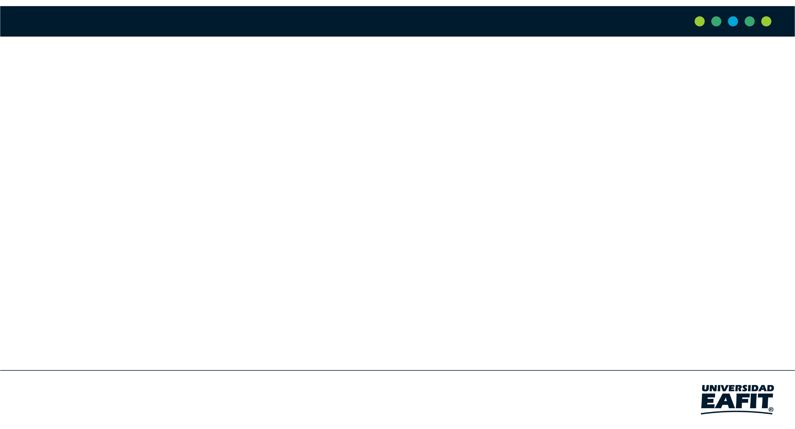
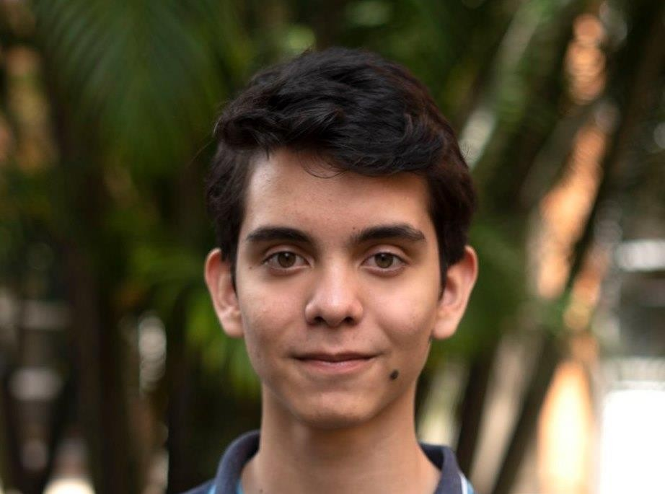

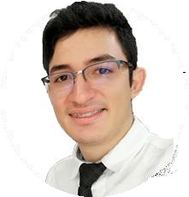


Team Presentation
Complete this slide
For the first deliverable
Kevin Torres
Vladlen Shatunov
Miguel Correa
Mauricio Toro
http://github.com/
vshatunovv
/proyecto/

Slide 3
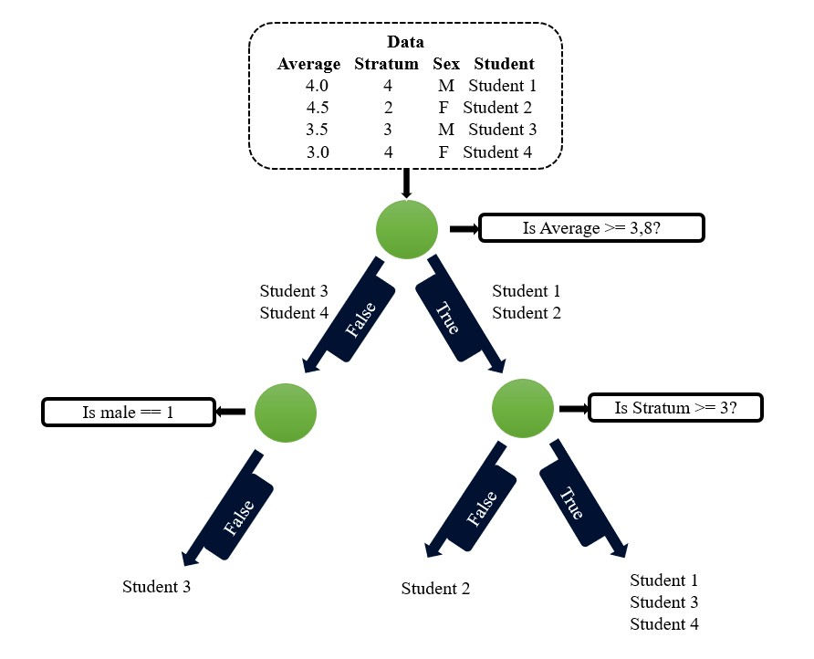

Algorithm Design
The following image explains how to separate the parameters or variables that describe each copy in the CART decision tree. The following example shows a decision tree for 4 students where the parameters are socioeconomic stratum, average in high school and sex

Slide 4





















Node Splitting
Is Square ?
Gini Impurity = 0
Gini
Impurity = 0,33
The purity of Gini is used as an indicator of how the conditions and depth of the branches explain the data. We can see that in the previous example, when asking which of the office materials have the characteristic of being square, the algorithm separates the markers from the rest of them, so when the characteristic (not square) is mentioned, the markers will always be referred to, in this case the purity of Gini is zero.

Slide 5

Algorithm Complexity
 | Time Complexity | Memory Complexity
Training the model | O(N*M) | O(N*M)
Testing the Model | O(Log N*M) | O(1)
Time and memory complexity of the CART algorithm.
N means the number of operations.
M means the number of variables

Slide 6
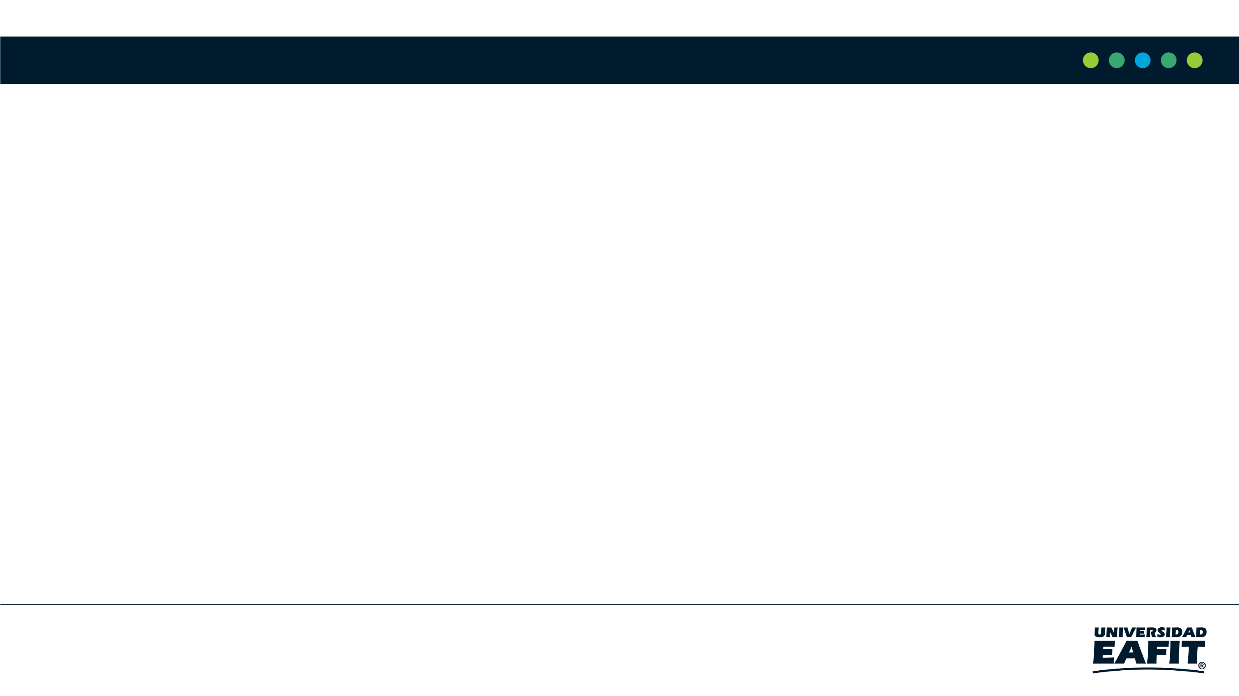
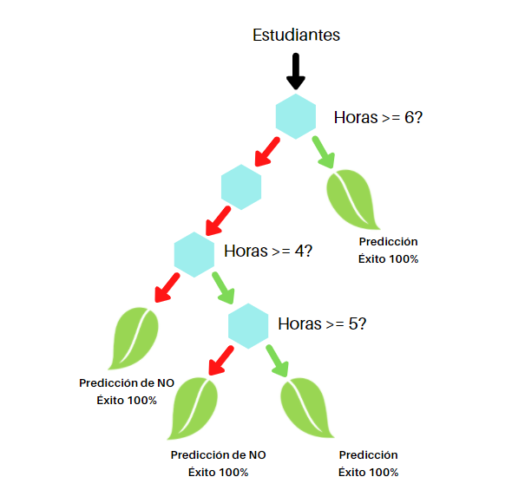
Decision-Tree Model
Most Relevant Features
Social Studies English Gender
A binary decision tree to predict Saber Pro scores based on the results of Saber 11. Violet nodes represent those with a high probability of success, green medium probability and red a low probability of success.

Slide 7


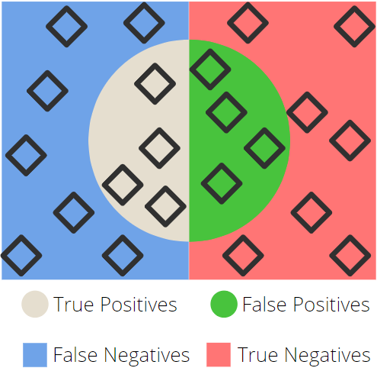

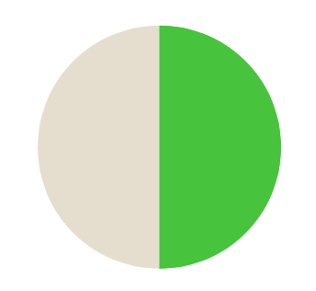

Evaluation Metrics
Recall
Presicion
Accuracy

Slide 8

Evaluation Metrics
 | Training data set | Testing data set
Accuracy | 96,29% | 97,56%
Precision | 92,6% | 95,13%
Recall | 100% | 100%
Evaluation metrics using a training dataset of 135,000
students and test dataset of 45,000 students. We can see that this model of our is very precise and has little to no errors when were talking of big amounts of data

Slide 9
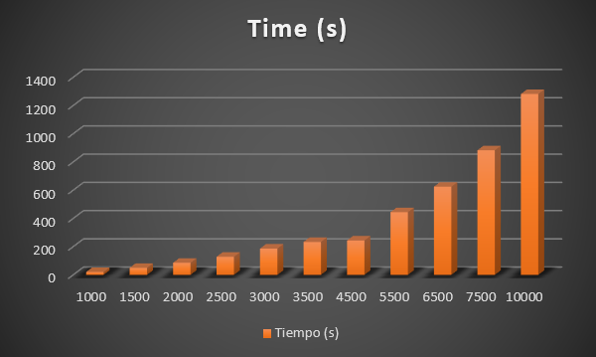
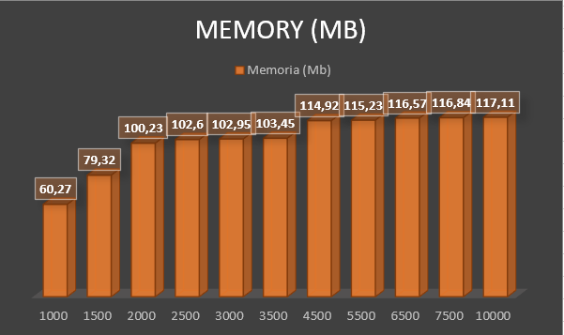


Time and Memory Consumption
Time Consumption
Memory Consumption

Slide 10
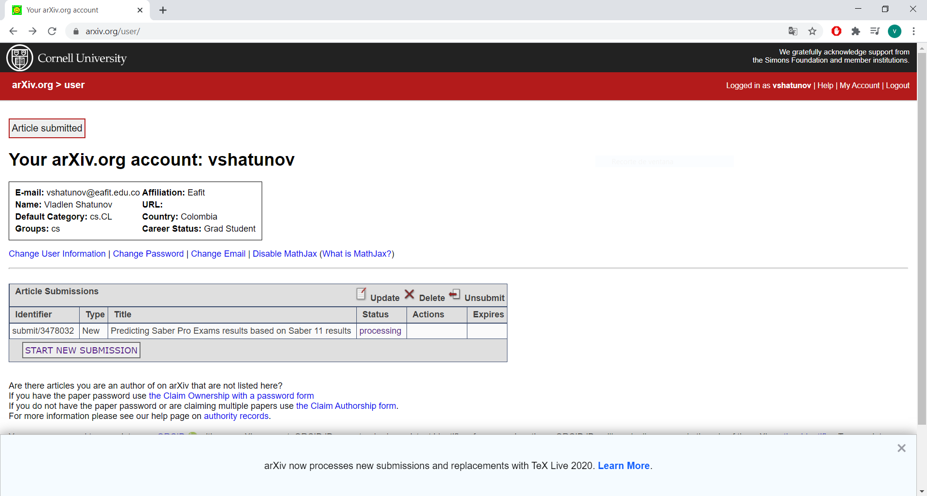
Report Accepted on arXiv
Status: Scheduled to be announced

Slide 11
THANK YOU!

